Slide 1
Group 9 Demo
Group 9
Xuanyu Zhao a1655611
Yawen Luo a1657343
Wei Zhang a1657881
Supervisor: Sergey Polyakovskiy

Slide 2
Jack is the manager of a logistics company.
His company owns several types of vehicles (trucks), each type has different size and capacity.
The company is busy and needs to deliver lots of items to lots of customers everyday.
Items have different length, width and weight.
Customers located in many different positions.
Each truck picks up items from depot (warehouse), visits one or more customers in turn and finally comes back to depot.
----------------- This is called a route!
Customers are lazy! They don’t want to sign the receipt twice.
---------------- One customer must be served by only one truck.

Slide 3
What problem makes Jack very annoyed but he has to face it everyday?

Slide 4
Today’s work list:
Deliver a fridge, a TV and a book to Mr A in ChinaTown;
Deliver a smart phone to Mr B in Adelaide Airport
Deliver a mac and 2 desks to Mr C in Adelaide Uni
Deliver 3 boxes and a sofa to Mr D in Glenelg beach
…………………………….
if > 100 customers && > 200 items
How to arrange routes ?
how many trucks to use?
the type of each truck
which truck should serve which customer(s)
To make Jack’s total cost(total distance) minimum.

Slide 5
Jack doesn’t know how to arrange the routes.
This becomes a big headache of him and makes him upset.
Jack! Don’t worry any more!
Come to Group 9!
Our project is for you!

Slide 6
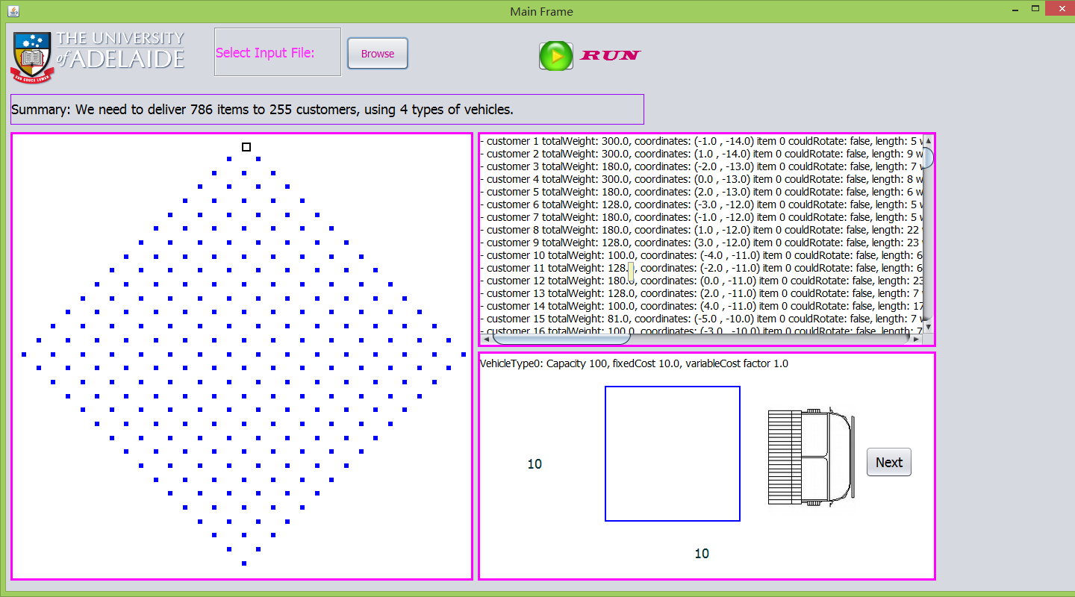
Big input: 255 customers, 786 items

Slide 7
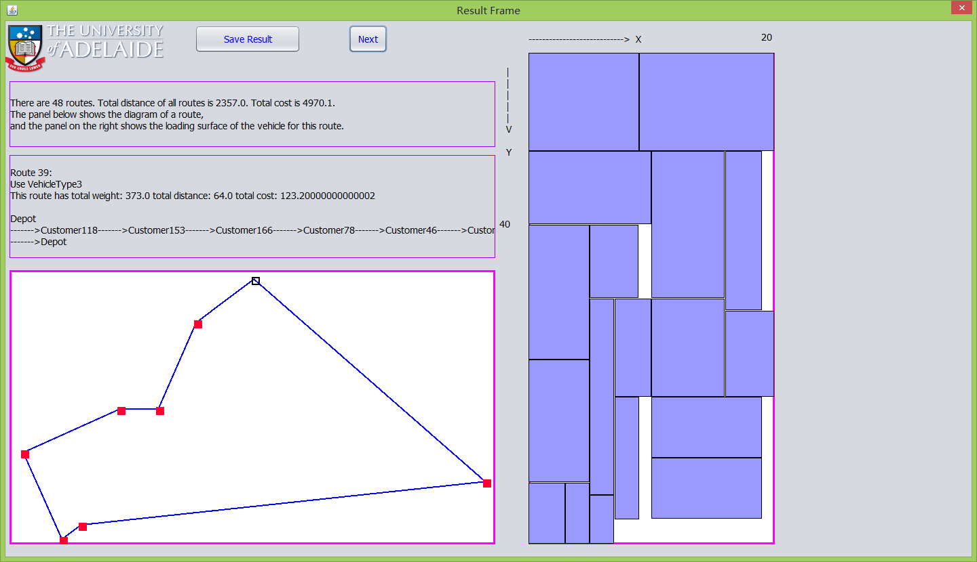

Slide 8
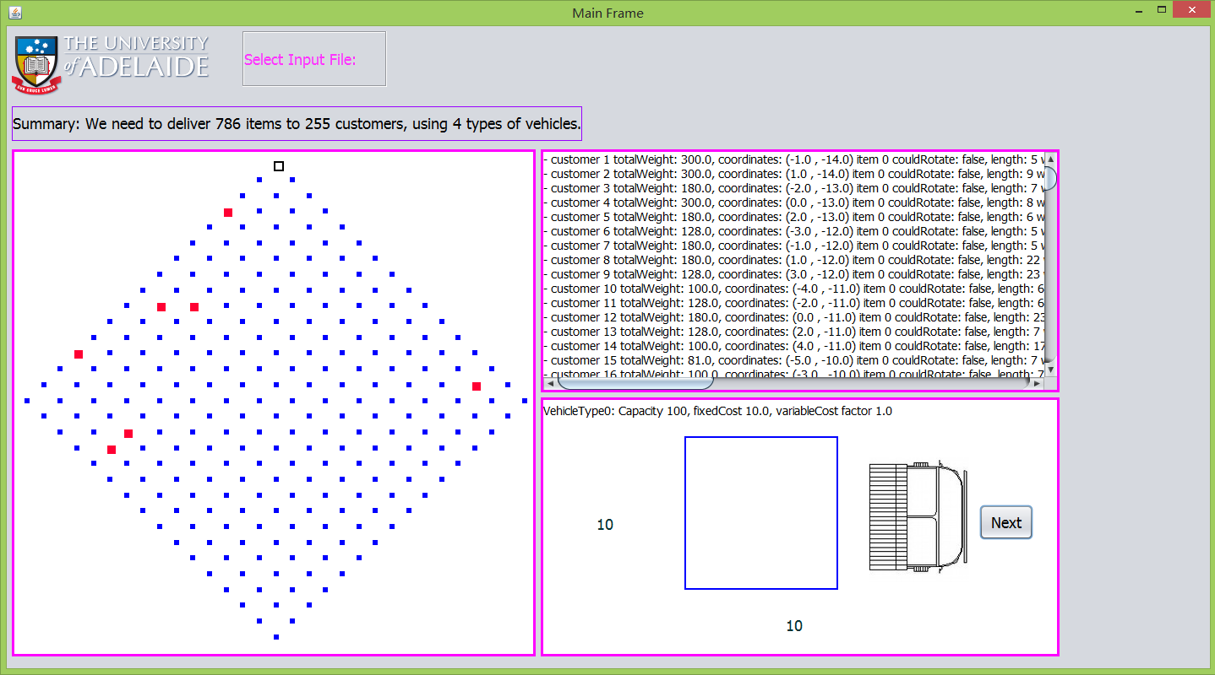

Slide 9
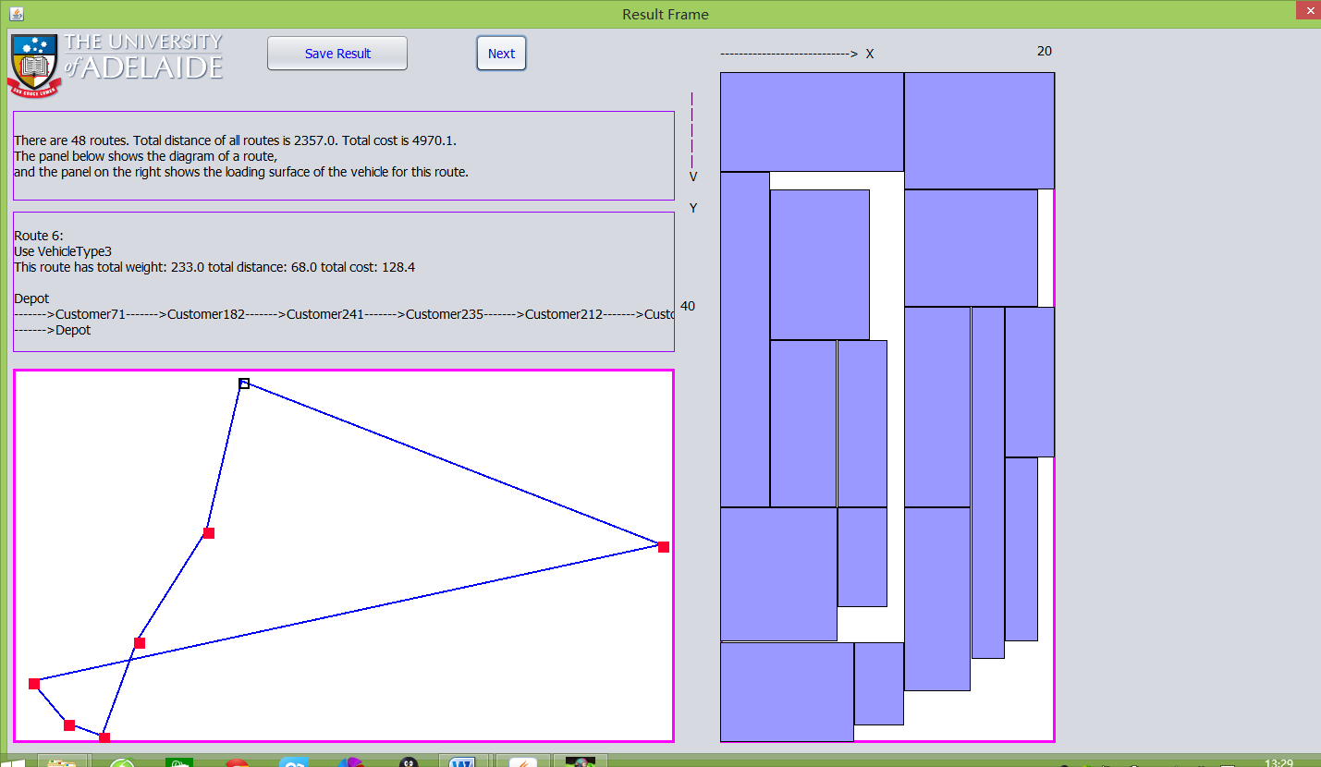

Slide 10


